Slide 1
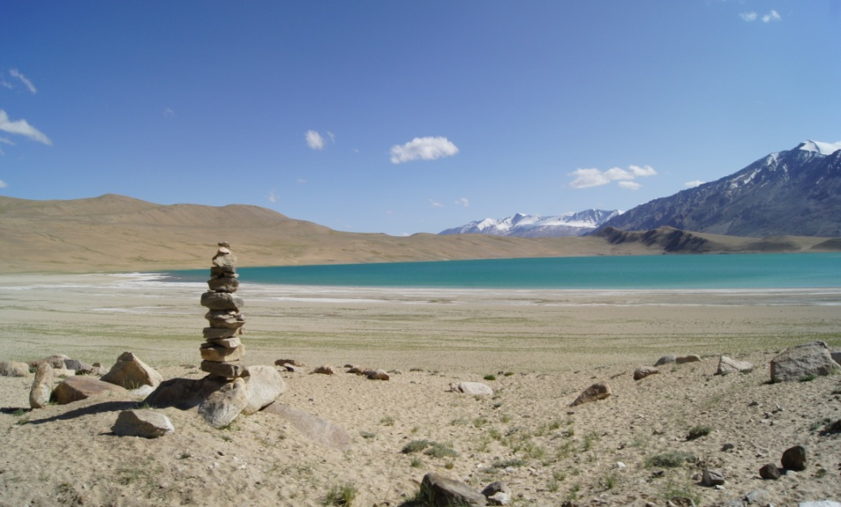
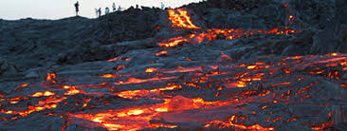
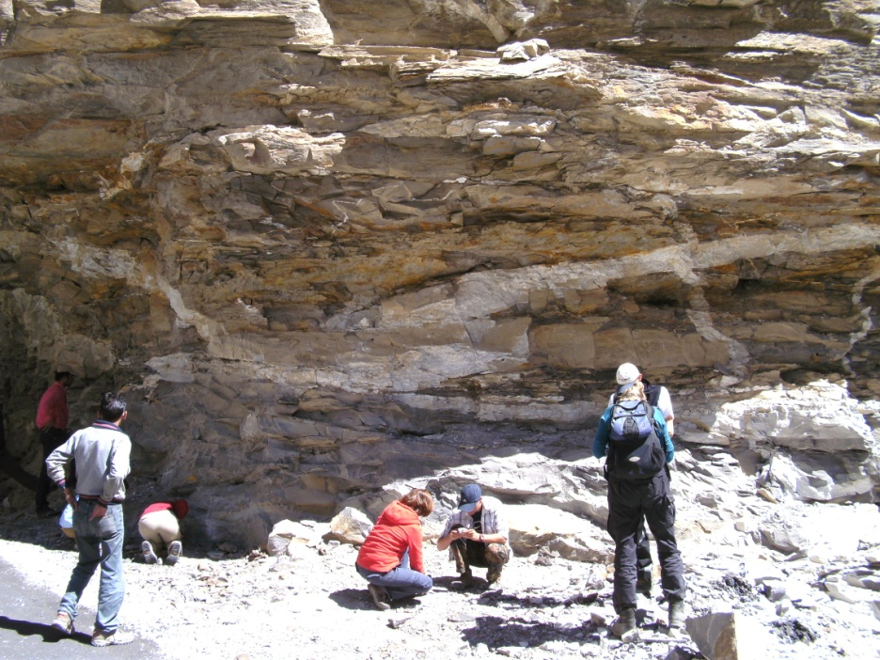
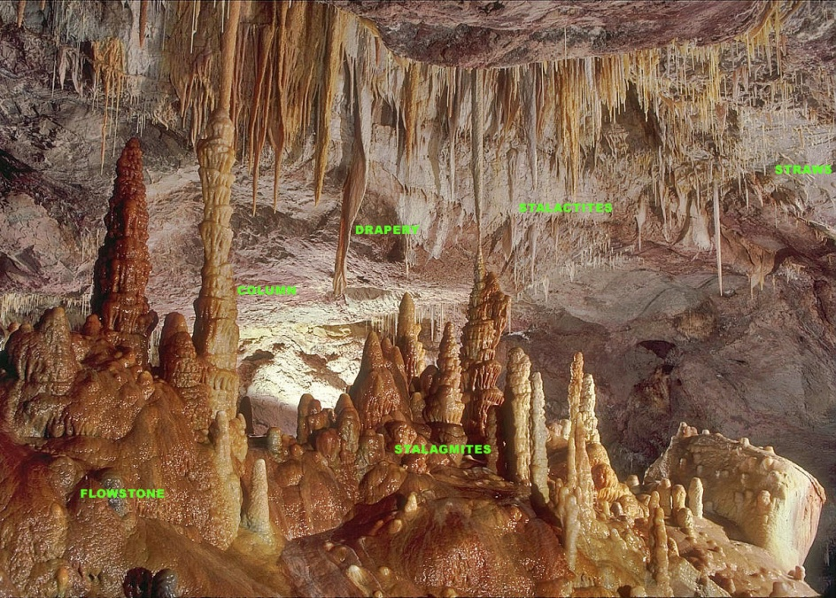
IDC203: IDC:203: Introduction to Earth Sciences

Slide 2
Sedimentary rocks
Weathering –Decomposition and disintegration of pre-existing rock into small fragments or new minerals
Transportation of the sediments to a sedimentary basin
Deposition of the sediment
Burial and Lithification to make sedimentary rock

Slide 3
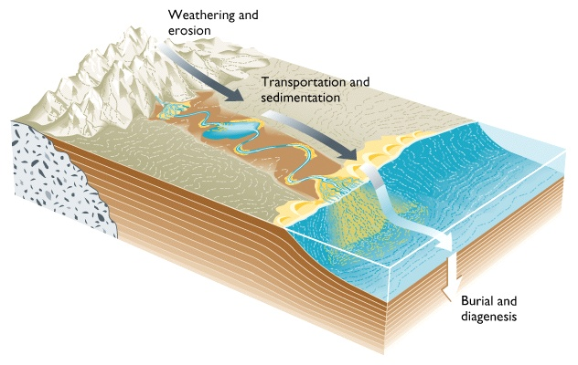
Sedimentary stages in the rock cycle
Fig. 7.1

Slide 4
Sedimentary rocks
Weathering process
Types of sedimentary rocks
Depositional environments

Slide 5
Weathering process
Physical (Mechanical): Large rocks broken into smaller fragments with no change in composition
2. Chemical: Rocks dissolved –
chemical and mineralogical composition can be altered • new minerals may form
3. Biological : plants & animals

Slide 6
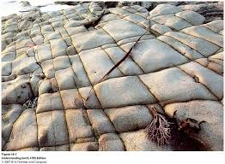
Physical weathering
1. Joints (also termed extensional fractures) are planes of separation on which no shear displacement has taken place

Slide 7
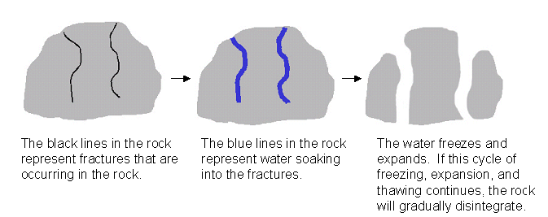
Physical Weathering
2. Frost wedging

Slide 8
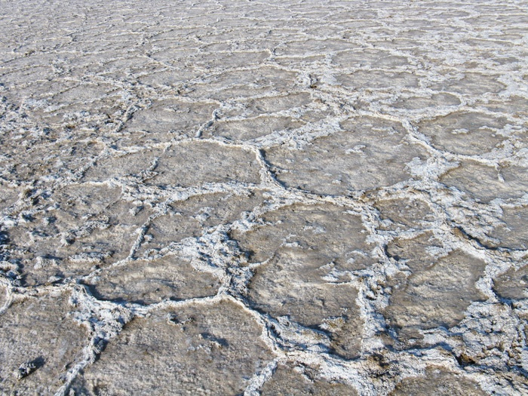
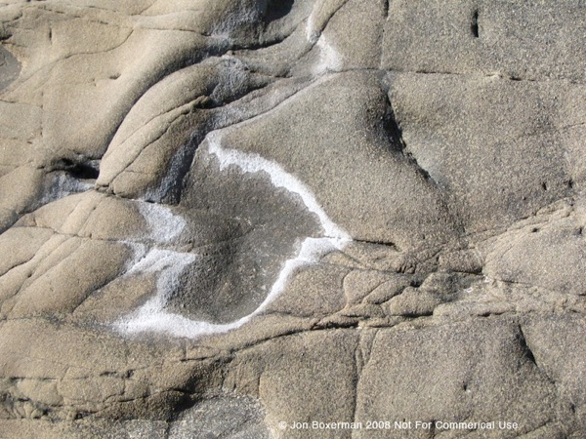
Physical Weathering
3. Salt precipitation

Slide 9
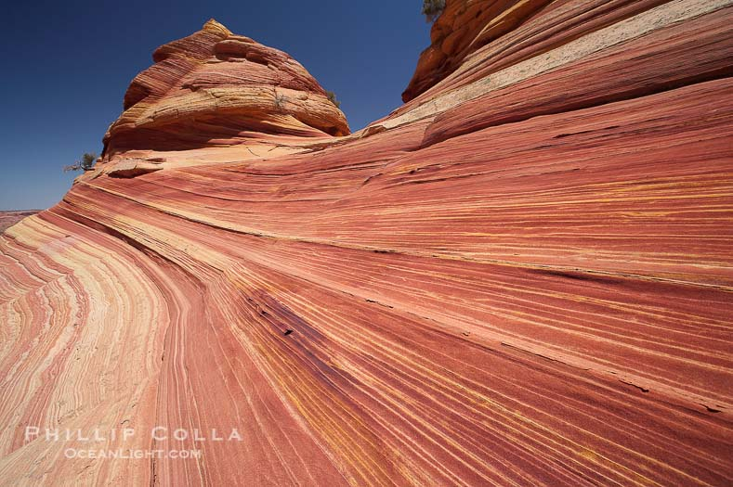
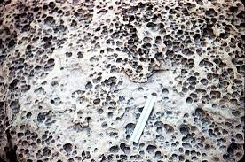
Physical Weathering
4. Abrasion
Physical grinding of rock fragments

Slide 10
Chemical Weathering
Chemical weathering is the weakening and subsequent disintegration of rock by chemical reactions.
These reactions include
Hydration
Hydrolysis
Carbonation

Slide 11
Chemical Weathering
Carbonation is the process of rock minerals reacting with carbonic acid. Carbonic acid is formed when water combines with carbon dioxide. Carbonic acid dissolves or breaks down minerals in the rock.
CO₂ + H₂O → H₂CO₃ (carbon dioxide + water → carbonic acid)
CaCO₃ + H₂CO₃ → Ca²⁺ + 2HCO₃₋ (calcite + carbonic acid → calcium + bicarbonate)

Slide 12
Chemical Weathering
Hydrolysis is a chemical reaction caused by water.
Water changes the chemical composition and size of minerals in rock, making them less resistant to weathering.
2KAISi₃O₈ + 2H⁺ + 9H₂0 → H₄Al₂Si₂O₉ + 4H₄SiO₄ + 2K⁺

Slide 13
Chemical Weathering
Hydration is the absorption of water into the mineral structure.
A good example of hydration is the absorption of water by anhydrite, resulting in the formation of gypsum. Hydration expands volume and also results in rock deformation.

Slide 14
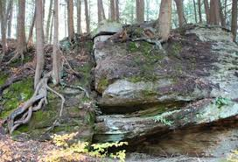
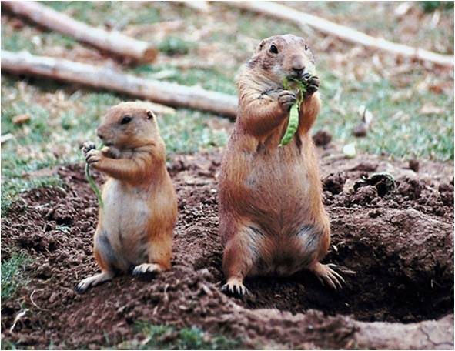
Biological Weathering
This form of weathering is caused by activities of living organism

Slide 15
Factors affect the rates of weathering process
Climate
Structural weakness
Topography
Time
Nature of rocks and minerals

Slide 16
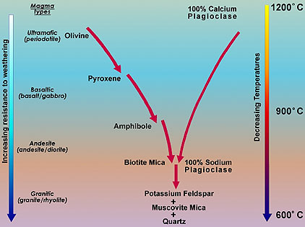
Weathering process

Slide 17
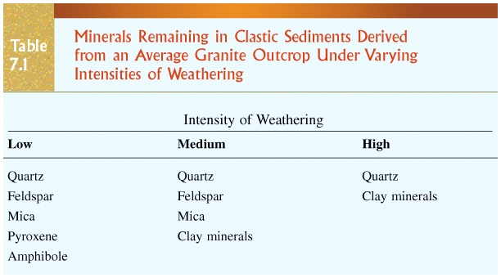

Slide 18
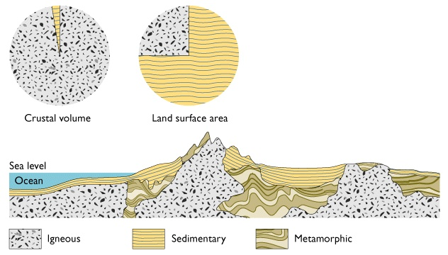
How common are sedimentary rocks?

Slide 19
Sedimentary Rocks
Detrital (clastic) rocks produced from rock fragments
Chemical rocks produced by precipitation of dissolved ions in water
Organic rocks produced by accumulation of biological debris, such as in swamps or bogs
Sedimentary rock types and sedimentary structures within the rocks give clues to past environments

Slide 20
Transport and deposition of Clastic sediments
Movement of sediment by wind, ice or water.
Mode of transport produces distinctive deposits.

Slide 21
Transport affects the sediment in several ways
Sorting: measure of the variation in the range of grain sizes in a clastic rock or sediment
Well-sorted sediments indicate that they have been subjected to prolonged water or wind action.
Poorly-sorted sediments are either not far-removed from their source or deposited by glaciers.

Slide 22
Sorting

Slide 23
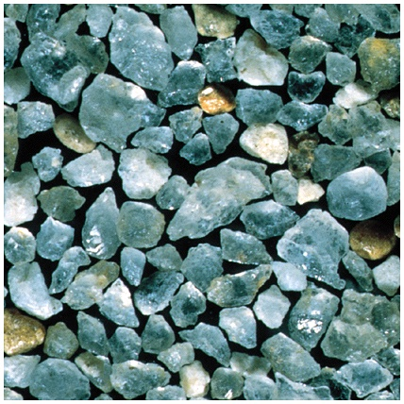
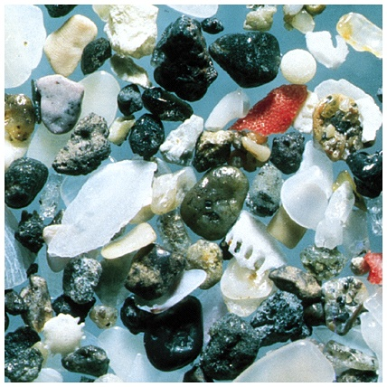
Well-sorted sand
Poorly-sorted sand

Slide 24
Transport affects the sediment in several ways
Roundness: measure of how rounded the corners are
Sphericity: measure of how much it is like a sphere
Sorting, roundness, and sphericity all increase with amount of transport.

Slide 25
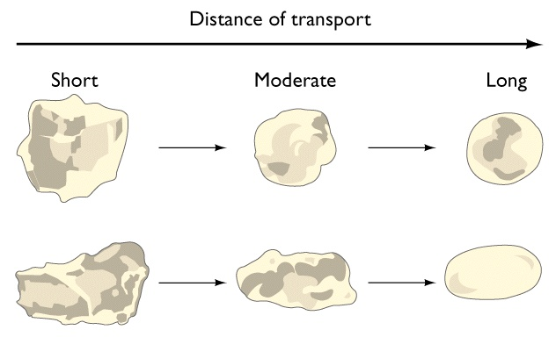
Roundness and sphericity

Slide 26
Types of detrital rocks
Largely based on the size of the particles, which may be anything.
Sediment -classified by particle size
Boulder - >256 mm
Cobble - 64 to 256 mm
Pebble - 2 to 64 mm ----
Sand - 1/16 to 2 mm
Silt - 1/256 to 1/16 mm
Clay - <1/256 mm
Gravel

Slide 27
Types of detrital rocks
Conglomerate
Breccia
Sandstone (quartzite, arkose, greywacke)
Shale
Mudstone
Siltstone

Slide 28
Clastic sedimentary rocks
Breccia and Conglomerate
Coarse-grained clastic sedimentary rocks
Sedimentary breccia composed of coarse, angular rock fragments cemented together
Conglomerate composed of rounded gravel cemented together

Slide 29
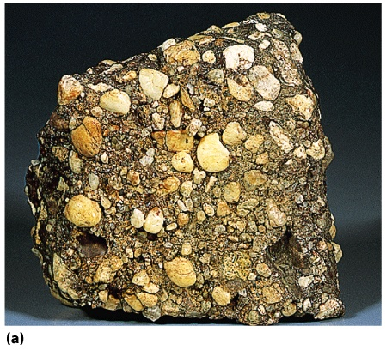
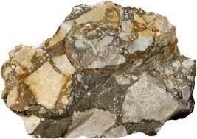
Conglomerate
Breccia
Fig. 7.15a
Breck Kent

Slide 30
Clastic sedimentary rocks
Sandstone
Medium-grained clastic sedimentary rock
Types determined by composition
Quartz sandstone - >90% quartz grains
Arkose - mostly feldspar and quartz grains
Graywacke - sand grains surrounded by dark, fine-grained matrix, often clay-rich

Slide 31
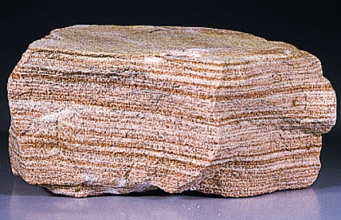
Sandstone
Fig. 7.15b
Breck Kent

Slide 32
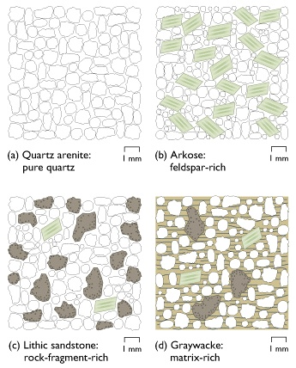
Four major groups of sandstones

Slide 33
Shale
Shales are clastic rocks, made up mainly fine silt/clay
They are most abundant sedimentary rocks, accounts for about 80% of them
Often contain fossils
Mostly hydrous aluminum silicate in composition = from weathered feldspars
Deposition takes place under low fluvial regime or under weak water current. Eg. Offshore or in Lagoon
Shales are made of fine well sorted silt and clayey sediments, where normally one can expect high porosity and permeability.

Slide 34
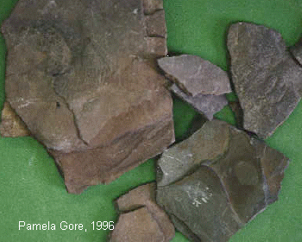
Shale

Slide 35
Types of chemical sedimentary rocks
Limestone CaCO₃
Chert SiO₂
Salt NaCl, KCl, K₂SO₄
Gypsum CaSO₄ • 2H₂O
Coal altered organic debris

Slide 36
Chemical sedimentary rocks
Carbonates
Contain CO₃ as part of their chemical composition
Limestone is composed mainly of calcite
Most are biochemical, but can be inorganic
Often contain easily recognizable fossils

Slide 37
Chemical sedimentary rocks
Limestone: It is a non-clastic rock formed either chemically or due to precipitation of calcite (CaCO₃) from organisms usually shell. These remains will result in formation of a limestone.
Limestones formed by chemical precipitation are usually fine grained, whereas, in case of organic limestone the grain size vary depending upon the type of organism responsible for the formation
Fossiliferous Limestone: which medium to coarse grained, as it is formed out of cementation of Shells.

Slide 38
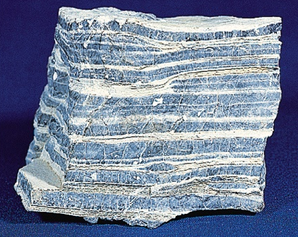
Limestone
Fig. 7.19a

Slide 39
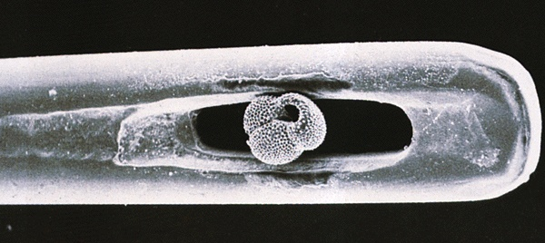
Foraminifera in the eye of a needle
Fig. 7.17

Slide 40
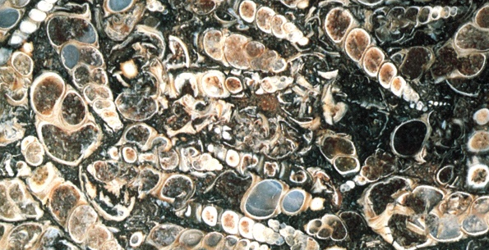
Fossiliferous limestone

Slide 41
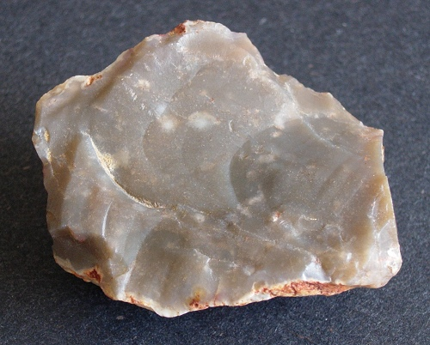
Chemical sedimentary rocks
Chert
Hard, compact, fine-grained, formed almost entirely of silica
Can occur as layers or as lumpy nodules within other sedimentary rocks, especially limestones

Slide 42
Evaporites
These rocks are formed within the a depositional basin from chemical substances dissolved in the seawater or lake water
Characteristic of arid conditions

Slide 43
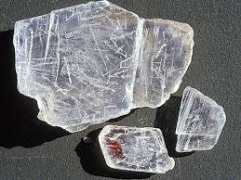
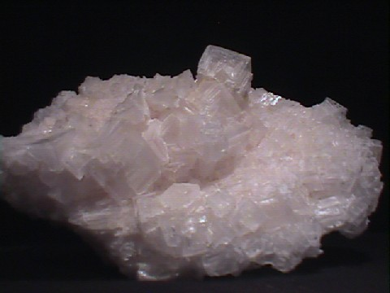
Evaporites
Minerals precipitate according to solubility.
Gypsum Halite
50% 90%
CaSO₄.2H₂0
NaCl

Slide 44
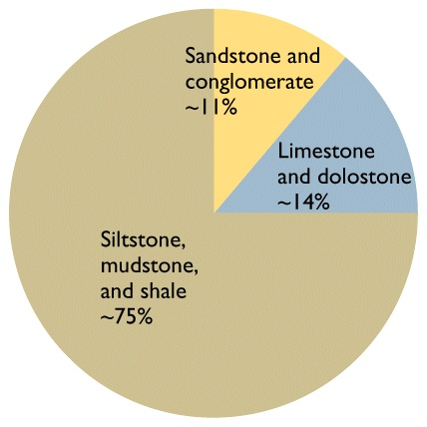
Relative abundance of sedimentary rock types

Slide 45
Sedimentary environment
Sediments accumulate in some environment of deposition or depositional environments
These areas receive net deposition
Erosion may occur, but deposition dominates
Features of these depositional environments are preserved in the rock record
Examples:
Sediment texture
Fossils of organisms that lived in the environment
Ancient environments can be reconstructed from the clues that are preserved in the sedimentary rocks

Slide 46
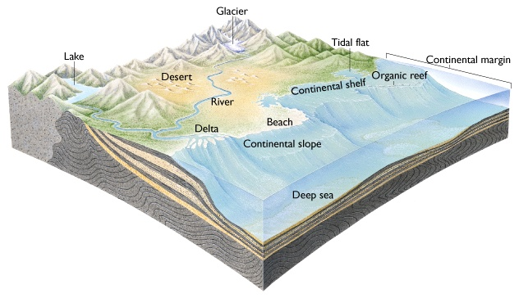
Common sedimentary environments

Slide 47
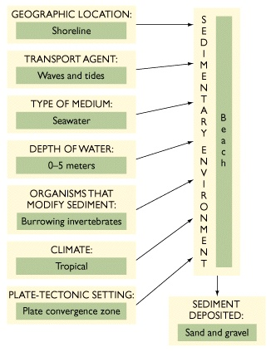
Characteristics of a sedimentary environment

Slide 48
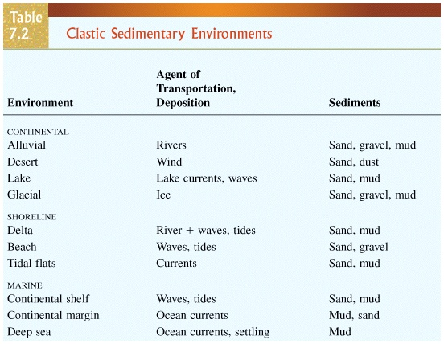

Slide 49
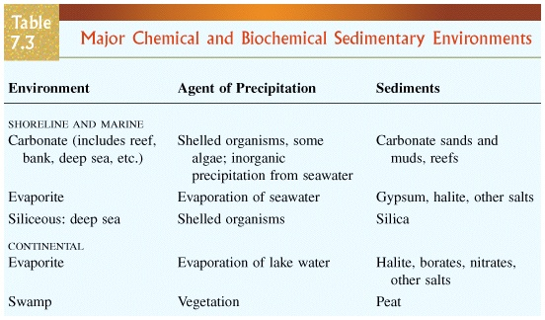

Slide 50
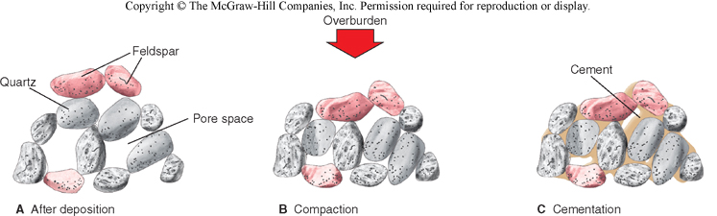
Lithification

Slide 51
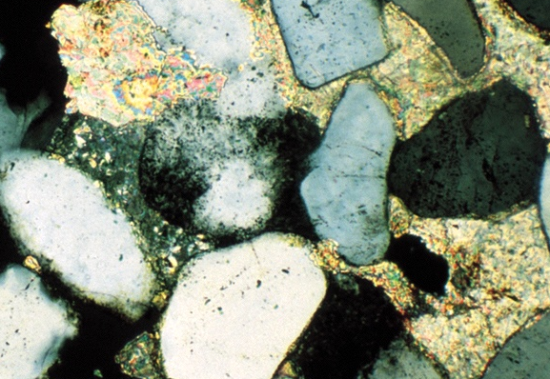
Calcite
cement
Quartz grain
Fig. 7.13
Peter Kresan

Slide 52
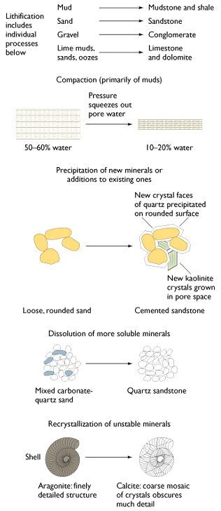
Products of lithification

Slide 53
From sediment to sedimentary rock (lithification)
Compaction: reduces pore space
Clays and muds are up to 60% water; 10% water after compaction.
Cementation: chemical precipitation of mineral material between grains (SiO₂, CaCO₃, Fe₂O₃) binds sediment into hard rock.
Recrystallization: P and T increase with burial 30°C/km or 1°C/33 m.

Slide 54
Compaction (Primarily of Muds)
Precipitation
of new minerals or additions to existing ones
Fig. 7.12

Slide 55
Dissolution of More Soluble Minerals
Recrystallization of Unstable Minerals

Slide 56
Clues to interpreting sedimentary environment
• Sedimentary structures
• Sorting, roundness, sphericity
• Sequence of beds

Slide 57
Environment of deposition
Modern Analogue
Key to interpreting transport history of sediments and rocks
Model
Based on idea that a “particular set of environmental conditions operating at a particular intensity will produce a sedimentary deposit with a unique set of properties that will identify if as the product of a particular environment”
(Boggs, 2001)

Slide 58
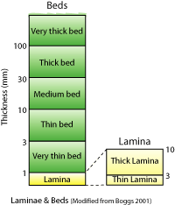
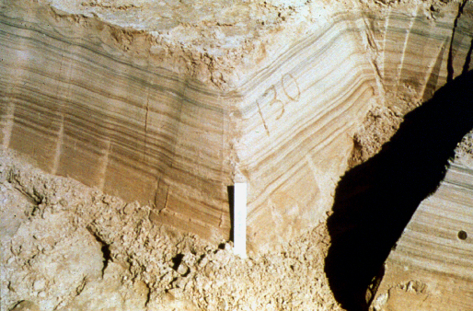
Sedimentary Structures
Bedding
Series of visible layers within a rock
Most common sedimentary structure

Slide 59
Sedimentary structures
Stratification = bedding = layering
Produced due to differences in
1. size of particles
2. kinds of particles

Slide 60
Sedimentary structures
Particular structural features can give information about the environment of deposition.
Structures also help determine if a bed is right-side-up.
— this is important in deformed rocks

Slide 61
Environment of deposition
Modern Analogue
Key to interpreting transport history of sediments and rocks
Model
Based on idea that a “particular set of environmental conditions operating at a particular intensity will produce a sedimentary deposit with a unique set of properties that will identify if as the product of a particular environment”
(Boggs, 2001)

Slide 62
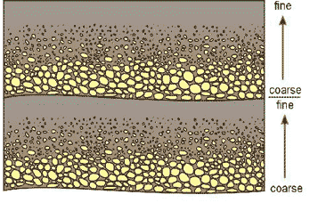
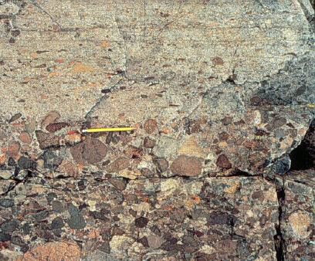
Graded bedding
Scale may be mm to m

Slide 63
Fossils
Traces of plants or animals preserved in rock
Hard parts (shells, bones) more easily preserved as fossils

Slide 64
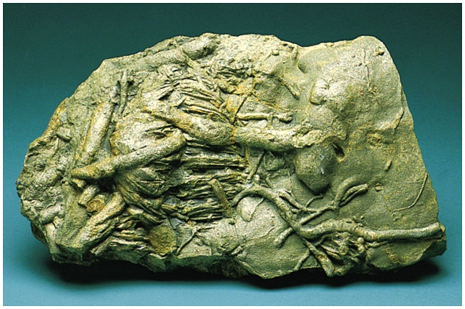
Bioturbation tracks and tunnels

Slide 65
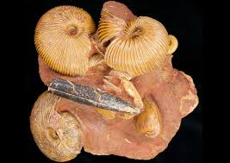
Fossils

Slide 66
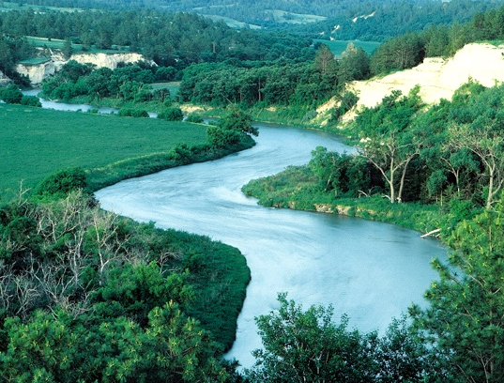
Streams: transport to the ocean

Slide 67
Rivers and streams
Stream : body of water flowing in a channel
The floor of the channel is called the bed.
When rainfall is very heavy or snow melts rapidly, bodies of water overflow their banks and water covers the adjacent land called the floodplain.

Slide 68
Rivers and streams
Carry away runoff to lakes and seas
Erode land (degradation)
Transport and deposit sedimentary debris

Slide 69
Stream behavior
Mostly determined by velocity and shape of channel.
These factors combine to allow either laminar or turbulent flow.
Turbulent flow is much more erosive.
Stream velocities may vary from 0.25 to 7 m/s.

Slide 70
Laminar flow
Smooth sheet-like flow at a low velocity
Usually confined to edges and top of stream

Slide 71
Turbulent flow
Irregular swirling flow
Occurs at most rates of stream flow
Keeps particles in suspension

Slide 72
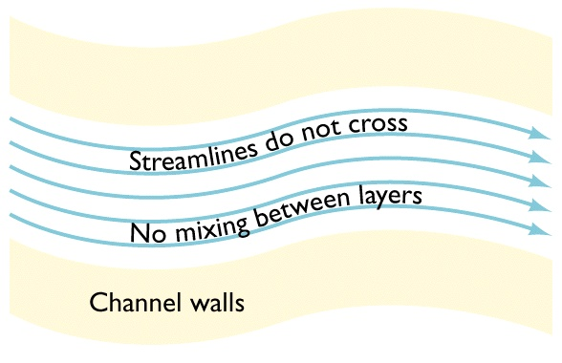
Laminar flow

Slide 73
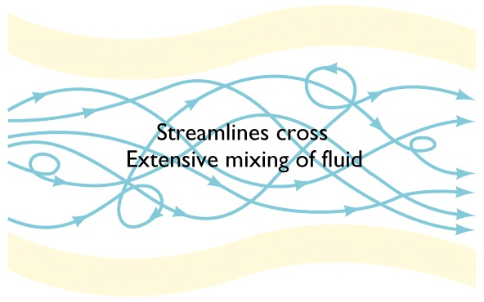
Turbulent flow

Slide 74
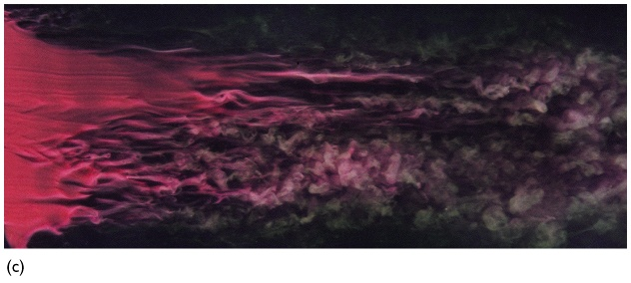
Laminar to turbulent transition
Laminar flow
Turbulent flow
ONERA
Fig. 13.1c

Slide 75
Streams move material in three forms
Dissolved load
Suspended load
Bed load (traction and saltation)

Slide 76
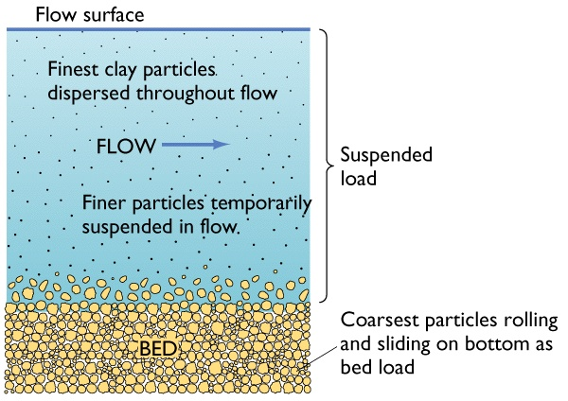
Sediment Transport

Slide 77
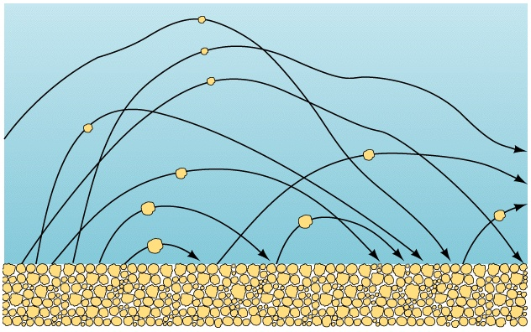
Saltation

Slide 78

Grain size and flow velocity

Slide 79
Stream terms
competence: measure of the largest particles a stream can transport proportional to v²
capacity: maximum quantity of sediment carried by stream proportional to Q and v

Slide 80
Discharge
Total amount of water that passes a given point in a stream per unit time
Q = w d v
Discharge (m³/s) = width (m) × depth (m) × average velocity (m/s)

Slide 81

Lower velocities form ripples
ripple

Slide 82

Higher Velocities Form Dunes
ripples
dune
dune
Fig. 13.5b

Slide 83

Waterfall retreating upriver
Fig. 13.7
Donald Nausbaum

Slide 84

Parts of a River System

Slide 85
Two important stream types
1. Meandering Streams
A meander, in general, is a bend in a sinuous watercourse or river.
A meander forms when moving water in a stream erodes the outer banks and widens its valley, and the inner part of the river has less energy and deposits silt

Slide 86

Meandering River Over Time

Slide 87

Incised Meanders, Utah
Tom Bean

Slide 88

Meandering River
Point Bar

Slide 89
Two important stream types
2. Braided Streams
Sediment supply greater than amount stream can support.
At any one moment the active channels may account for only a small proportion of the area of the channel system, but essentially all is used over one season.
Common in glacial, deserts, and mountain regions.

Slide 90

Lateral migration by erosion at the outside & deposition on the inside of the river

Slide 91

Braided River

Slide 92

Formation of Natural Levees

Slide 93
Discharge
Total amount of water that passes a given point in a stream per unit time
Q = w d v
Discharge (m³/s) = width (m) × depth (m) × average velocity (m/s)

Slide 94

River at low discharge

Slide 95

River at high discharge

Slide 96
Flooding
Water in the stream is greater than the volume of the channel.
Interval between floods depends on the climate of the region and the size of the channel

Slide 97

City Built on a Floodplain

Slide 98
Recurrence interval
Average time between the occurrences of a given event
The recurrence interval of a flood of a given size at a given place depends on:
• climate of the region
• width of the floodplain
• size of the channel

Slide 99

Longitudinal Stream Profile of the Platt and South Platt Rivers

Slide 100

Role of Base Level in Controlling Longitudinal Profile of Rivers

Slide 101
Base level
Elevation at which a stream enters a large body of water such as a lake or ocean

Slide 102

Effects of building a dam original profile graded to regional base level

Slide 103

Effects of Building a Dam : Dam Forms New Local Base Level

Slide 104

Effects of Building a Dam Deposition Upstream and Erosion Downstream

Slide 105
Graded stream
Stream in which neither erosion nor deposition is occurring, due to an equilibrium of slope, velocity, and discharge.

Slide 106
Geologic evidence of changes in stream equilibrium
Alluvial fans
Terraces: erosional remnants of former floodplains

Slide 107

Alluvial fans
Alluvial Fans

Slide 108

Formation of River Terraces

Slide 109
Drainage basin
Area of land surrounded by topographic divides in which all the water is directed to a single point

Slide 110

Drainage divides separate adjacent drainage basins

Slide 111

Typical drainage networks

Slide 112
Delta
Location of significant sedimentation where a river meet the sea.

Slide 113

Typical Large Marine Delta
Fig. 13.27

Slide 114

Geologic time

Slide 115

Amount of time required for some geologic processes and events

Slide 116
Geologic time
A major difference between geologists and most other scientists is their attitude about time.
A "long" time may not be important unless it is > 1 million years.

Slide 117
Two ways to date geologic events
Relative dating (fossils, structure)
2) Absolute dating (isotopic, radioactive dating)

Slide 118


Ammonite Fossils
Petrified Wood
Chip Clark
Fig. 9.4
Tom Bean

Slide 119

Using fossils to correlate rocks

Slide 120
Steno's laws
Nicolaus Steno (1669)
Principle of Superposition
Principle of Original Horizontality
Principle of Lateral Continuity
Laws apply to both sedimentary and volcanic rocks.

Slide 121
Principle of superposition
In a sequence of undisturbed layered rocks, the oldest
rocks are on the bottom.

Slide 122

Principle of superposition
Youngest rocks
Oldest rocks

Slide 123
Principle of original horizontality
Layered strata are deposited horizontal or nearly horizontal or nearly parallel to the Earth’s surface.

Slide 124

Principles of original horizontality and superposition
Fig. 9.3a

Slide 125
Principle of lateral continuity
Layered rocks are deposited in continuous contact.

Slide 126

Principle of lateral continuity

Slide 127
Unconformity
A Buried surface of erosion

Slide 128

Sedimentation of beds A-D beneath the sea

Slide 129
Uplift and exposure of D to erosion

Slide 130
Continued erosion removes D and exposes C to erosion

Slide 131
Subsidence and sedimentation of E over C
Unconformity:
a buried surface of erosion

Slide 132

The Great Unconformity of the Grand Canyon
Geoscience Features Picture Libraryc
Fig. 9.7

Slide 133

Formation of an angular unconformity

Slide 134
Formation of a disconformity
Fig. 9.6

Slide 135

Angular unconformity, grand canyon

Slide 136

Nonconformity in the grand canyon
Tapeats Sandstone
(~550 million years old)
Vishnu Schist
(~1700 million years old)

Slide 137

Symmetrical ripples

